Slide 1
“An Efficient AI Model for Tourism Recommendation”
Team ID : MP23CSE051
Priyanshi Kamboj Aditya misra Shruti Bajpai
(2016928) (2016586) (2016044)
Under the Supervision of
Dr. Ankit Tomar (assistant professor)

Slide 2
Introduction
Traveling in itself is an experience, a combination of the journey, the destination, time spent traveling, the stay, the season, and the activities undertaken. Tourists typically seek assistance while organizing a tour to make the most of their travel outings.
For this, they turn to the internet. However, there is an abundance of information on the web about many tourism-related topics, making it time consuming to find a suitable trip package, product, or service. This is where a recommender system comes in the picture.
A recommendation system can help with various tour related queries like where to travel and best point of interests (POI) in a city. It can also recommend places based on the places previously travelled by the user. hence, if used correctly, a recommender system can prove to be a very powerful tool in the tourism industry.

Slide 3
Problem statement
To Build a Tourist Recommendation System that utilizes various domains of artificial intelligence, particularly machine learning algorithms to efficiently suggest Places of Interest (POI) to users.
Tourists often face a sequential decision-making problem, while planning their visit to a destination or when at the destination continuing an already initiated trajectory of visited POIs.
With the addition of Artificial Intelligence (A.I.) into the frame, the task gets much easier. Against the foregoing backdrop, this project proposes and executes a tourist recommendation system based on processes data mining and various filtering methods.

Slide 4
Objectives
Our goal is to efficiently plan travel routes that encompass the user's preferred destinations, taking into account their geographical locations. We specifically aim to generate aesthetically pleasing travel routes that cover captivating tourist sites.
Visitor Experience Enhancement: Focus on improving the overall experience of tourists by providing high-quality services, facilities, and attractions.
Increase Tourist Satisfaction: Through our application, users will be able to input multiple preferences, ensuring a personalized travel experience
Monitor and Respond to Visitor Feedback: Collect and analyze feedback from tourists to continuously improve services and address any concerns or issues.
Suitability For Travel: Additionally, our system incorporates a weather predicting classifier that accurately forecasts the best months to travel from the source to the destination.

Slide 5
Literature Survey
S.NO | AUTHORS/YEAR | TITLE | OBSERVATIONS
1 | Bo Qiu and Wei (David) Year : 2021 | Machine Learning Based Short-Term Travel Time Prediction | Short-term TTP is a key component of the Advanced Travelers Information System (ATIS) in which in-vehicle route guidance systems (RGS) enable the generation of the shortest path for travelers, which connects the destinations and current locations. To identify whether the TTP is region-specific, further research is needed to replicate this study in other road categories using other types of data sources. Further results need to be achieved to compare all methods to further demonstrate whether the ensemble tree-based learning methods have better predictive accuracy in short-term TTP.
2 | Hend Alrasheed, Arwa Alzeer, Arwa Alhowimel,Nora shamer | A Multi - Level Tourism Destination Recommender System | The system incorporates two levels of recommendations as each user request undergoes two levels of recommendations. The first level involves providing the user with a set of destinations that matches her preferences (based on the preferences of similar users). The second level ranks the set of destinations based on the user preferences and constraints.
3 | Richa Sharma, Shalli Rani, Sarvesh Tanwar Year : 2019 | Machine Learning Algorithms for building Recommender Systems | This article presents an overview of the state-of-the-art Recommender systems with the prime focus on hybrid recommender systems. Further, different categories of hybridization models are studied, and the existing work is classified categorically based on the hybrid model they follow, and the Machine learning algorithm used.

Slide 6
S.NO | AUTHORS/YEAR | TITLE | OBSERVATIONS
4 | Charnsak Srisawatsakul, Waransanang Boontarig Year : 2020 | Tourism Recommender System using Machine Learning | The objective of this study is to develop the prototype of a tourism recommender system that automatically understands the user's preferences of their favorite tourist attractions without asking them any question. It applied machine learning to extract the user's preferences from the user's Instagram photos.
5 | Bilal Adualgalil, Sajimon Abraham Year : 2020 | Tourist Prediction using Machine Learning Algorithms | In the context of tourism, machine learning techniques are commonly used for three purposes: forecasting tourist expenses, analyzing tourist profiles, and predicting the number of tourist arrivals. This section provides a concise overview of ten machine learning techniques that support these activities.
7 | Ismat Fathima Bonthu Kotaiah Year : 2022 | Deep Learning based Tourism recommendation system | The research in this broad area has been studied extensively, and this paper provides a current overview of that research, taking into account the various interface types, the range of recommender algorithms, the features that such models provide, and their application of artificial intelligence techniques. This survey also provides some insights on the development of the industry's most promising research areas for the following years.

Slide 7
METHODOLOGY
The existing recommendation systems provide options to the people based on their availabilities. The available systems focus only on optimising one type of travel opinion whether it is the total duration or the cost or the number of people. As a result people have to compare and visit multiple websites for getting a total overview about their trip which is very tiresome, also it consumes a lot of time.
The dataset which is used by all other recommender systems does not only contain the dataset for India, but also of multiple countries. As a result, this reduces the quality and quantity of the information available with reference to India.
To address the limitations of the existing systems, we have proposed ‘An efficient AI model for Tourism Recommendation’ to enhance travel experience for users. It involves solving for recommending travel destinations to assist in finding the Points Of Interest (POI’s) based on user’s decision/choice point.

Slide 8
The foundation of this project commences with the dataset curation process represented by, D = {d­­₁, d₂,……..,d_{n}} , where D is the curated dataset. It is done in three steps:
Data Identification: collecting/finding all the datasets from all over to gather comprehensive information.
Data Cleaning: all the missing values, typos, duplicate entries are treated along with correcting inconsistencies to prepare the data for use.
Data transformation: The cleaned data needs to be transformed into a specific format to be used by the algorithms.
Transitioning into the data preparation phase, the project applies rigorous cleaning and transformation processes, expressed by the following formulas:
Cleaned Data = Clean(D)
Transformed Data = Transform(Cleaned Data)
The resultant dataset serves as the foundational element for the application of machine learning methodologies.

Slide 9
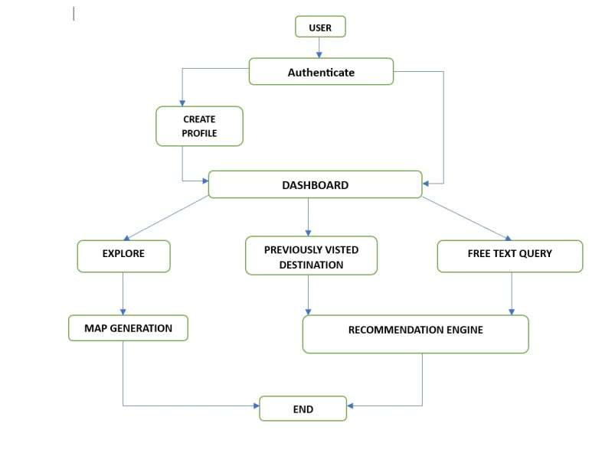
Architectural Design :
The architectural design of a tourism management system involves defining the overall structure, components, and interactions within the system.
The main components of system architecture diagram include:
Data Analysis and Recommendation Engine
User Profile
User Profile Management
Data Integration
Recommendation Generation
User Interface
User Feedback Management

Slide 10
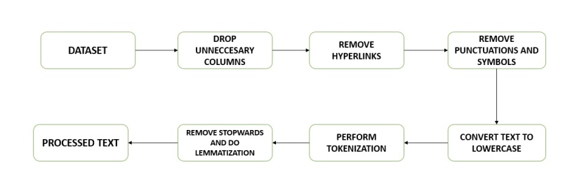
Data Processing
Data processing is a process of transforming the processed data into an actionable form. A number of steps are used in order to extract useful information, make decisions and gain insights.
For data processing we need to import RE (regular expressions) and we used NLTK (natural language took kit) for tokenization, lowercasing, removing stop words, and lemmatization to prepare your text data for further analysis.
The diagram depicts how data Processing is applied to the dataset:

Slide 11
Recommender Engine
To improve the recommendation efficiency and provide better experience to users, we have utilized cutting-edge algorithms. The recommender system is based on cosine similarity.
Recommendation based on recently visited destination:
It is based on finding the recommendation using the destination name in the user input. It uses cosine similarity for getting the result. Cosine similarity is a measure of similarity, often used to measure document similarity in text analysis. It computes the cosine similarity between pairs of vectors.
Similarity = (A.B) / (||A||.||B||)
In the formula we have used A and B as vectors and A.B is dot product and is calculated as element wise dot product of A and B added together, and ||A|| is L2 norm of A The square root of the sum of squares of the vector A's elements is used to calculate it.

Slide 12
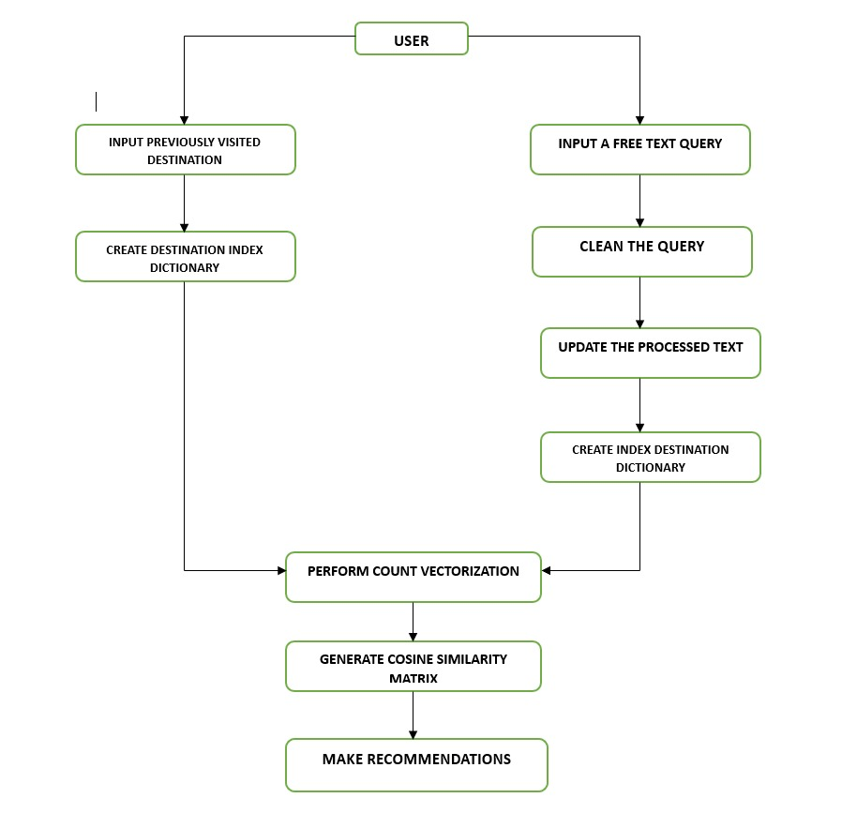
Implementation of recommendation engine:

Slide 13
Recommendation based on free text based query:
This type of recommendation uses NLP (natural language processing) to firstly clean the text query which involves tokenization, lowercasing, removing stopwords, and lemmatization for preparing the text data for further analysis.
The collaborative filtering can be expressed as the value of rating a user u given to item I as an aggregation of some similar user’s rating u’ on an item :
R_{u,I} = aggr_{u’∈U} r_{u’,I}
Here, U denotes the set of top n users which are very similar to user u who rated the item i. Using this, the user’s choice is understood really well leading to highly personalized recommendation.
Similarly, the integration of Scikit-learn (Sklearn) is captured by:
machine learning implementation = Sklearn
In the recommender engine we have used countvectorizer to convert a set of text into matrix of token counts. It is an essential tool for advancing NLP tasks.
cv = CountVectorizer()

Slide 14
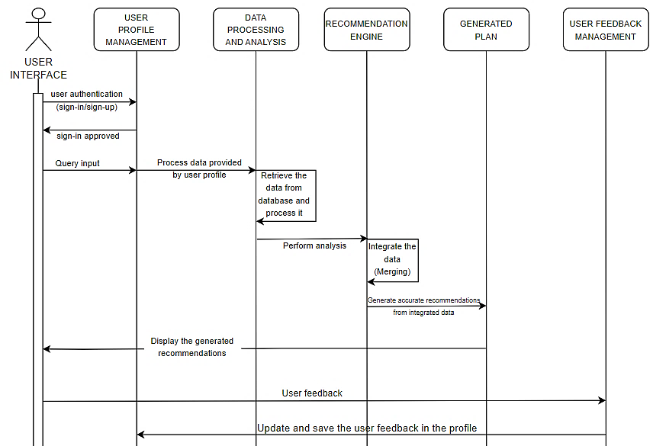
Sequence Diagram

Slide 15
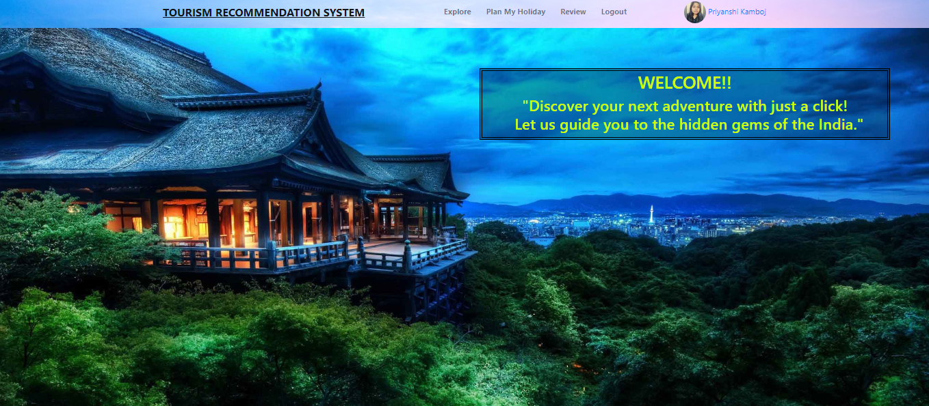
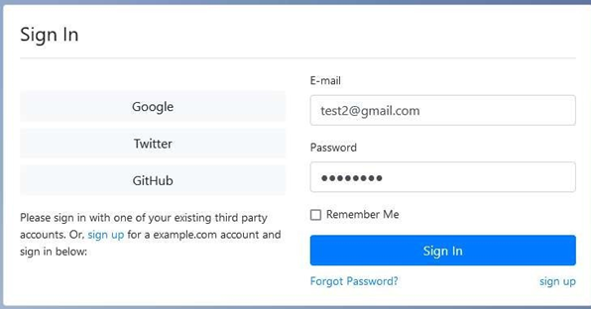
Result:
By focusing on personalized recommendations, the system enhances the engagement, satisfaction, efficiency and also enhances the visual appearance for the user resulting in providing a fantastic vacation by catering to individual interests/needs and ensuring an incredible travel experience.

Slide 16
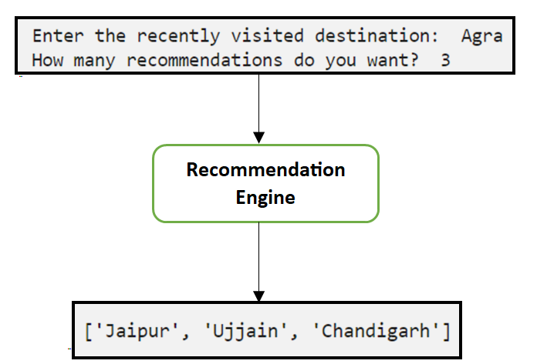
Conclusion and discussion:
The following pictures illustrate the two adopted ways to make recommendations:
The first picture shows the input from the user as a previously visited destinations. The recommendation engine the makes the recommendations and presents it to the user.

Slide 17
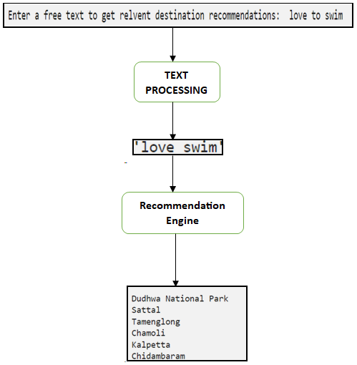
The second picture shows the input as a free text query from the user. The query is then processed by removing stop words, removing special symbols and punctuation marks and performing lemmatization.

Slide 18
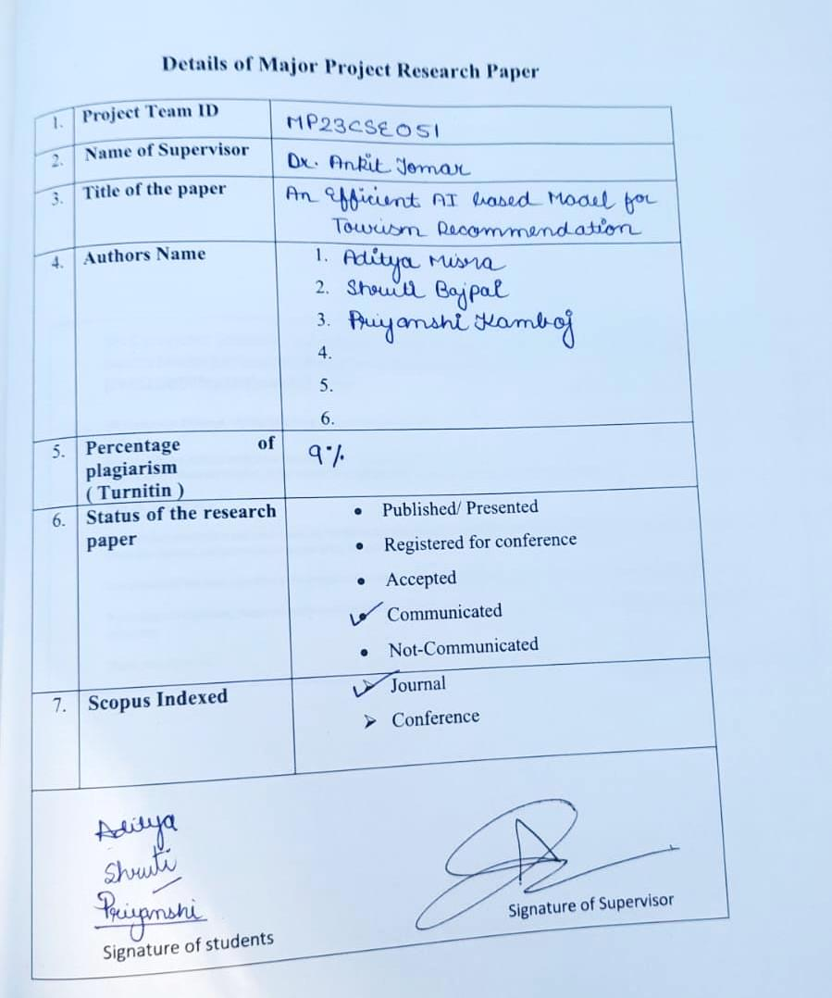

Slide 19
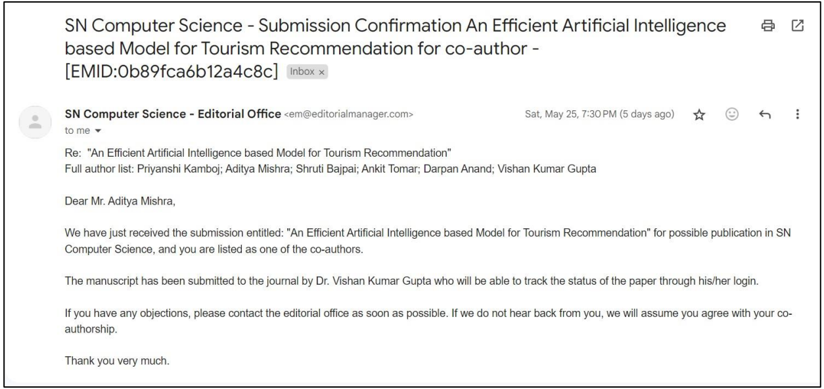

Slide 20
REFERENCES
Wang, D., Li, X., Huang, Z., & Tan, T. (2020). Intelligent tourism recommendation system based on user preferences and personalized tags. Journal of Ambient Intelligence and Humanized Computing, 11(5), 2033-2046.
Gretzel, U., Sigala, M., Xiang, Z., & Koo, C. (2015). Smart tourism: Foundations and developments. Electronic Markets, 25(3), 179-188.
Buhalis, D., & Sinarta, Y. (2019). Real-time co-creation and nowness service: lessons from tourism and hospitality. Journal of Travel & Tourism Marketing, 36(5), 563-582.
Zhang, H., Qu, Y., & Deng, Z. (2018). A novel personalized travel recommendation system combining social network and sentiment analysis. Information Processing & Management, 54(5), 819-832.
Zhong, L., Xu, W., Yang, S., & Wei, L. (2020). Intelligent tourism recommendation system based on collaborative filtering algorithm. Journal of Physics: Conference Series, 1512(1), 012043.
Fuchs, M., Höpken, W., Lexhagen, M., & Cantoni, L. (2014). Big data analytics for knowledge generation in tourism destinations–A case from Sweden. Journal of Destination Marketing & Management, 3(4), 198-209.
Li, X., Deng, L., Cao, S., & Li, F. (2019). Research on personalized travel recommendation system based on machine learning. International Journal of Pattern Recognition and Artificial Intelligence, 33(6), 1959010.

Slide 21
Sigala, M. (2018). From exploiting smart tourism ecosystems to real-time co-creation experiences. Journal of Hospitality & Tourism Management, 36, 18-25.
Gao, H., Ma, J., & Feng, B. (2020). Personalized travel recommendation algorithm based on LDA topic model. International Journal of Digital Earth, 13(5), 566-581.
Xiang, Z., Magnini, V. P., Fesenmaier, D. R., & Werthner, H. (2015). Information technology and consumer behavior in travel and tourism: Insights from travel planning using the internet. Journal of Retailing and Consumer Services, 22, 244-249.
Gabryel, P., & Jankowski, J. (2019). Tourism Recommendation Systems: A Literature Survey.
Xie, Z., Du, Q., & Xu, Y. (2015). Personalized Recommendation of Tourist Attractions Using Flickr Data.
Yin, Y., Zhang, Z., & Wang, G. (2018). Personalized Travel Package Recommendation Based on Tourists' Preference and Interests.
Ferlino, A., Mangano, F., & Loia, V. (2017). A Survey of Recommender Systems in Tourism.
Tan, A.-H., Yang, K.-H., & Miao, C. (2014). Context-aware Recommendation in Tourism: A Survey.
Xiong, Y., Wu, J., & Zhang, X. (2020). Tourism Recommendation System with Collaborative Filtering and Neural Network.
Phung, D., & Loke, S. W. (2012). An Ontology-based Approach to Personalized Recommendation of Tourist Attractions.
Wang, B., Ma, X., & Li, X. (2016). A Novel Personalized Tourist Route Recommendation Method Based on Genetic Algorithm and Collaborative Filtering.
Rana, S., Rana, N. P., & Dwivedi, Y. K. (2019). A systematic literature review on tourism recommender systems.
Kim, S., Han, S., & Lee, G. G. (2018). A Context-Aware Personalized Recommendation Algorithm Using Collaborative Filtering in Tourism.

